Slide 1
Building projects
Using ANT

Slide 2
No more play button

Slide 3
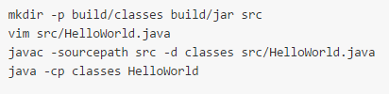
Building a project
The build process is long and tedious
Notes:
Picture taken from: https://github.com/sayar/talks/blob/master/ecse321/tutorial9/ant_tutorial.md
3

Slide 4

Introducing ANT
A command line tool to build your projects

Slide 5
Get Ant
Check if you have ant by typing the command:
ant –version
Get ant from: http://ant.apache.org/bindownload.cgi
Extract the files to a location of your choosing then add it to your path variable

Slide 6
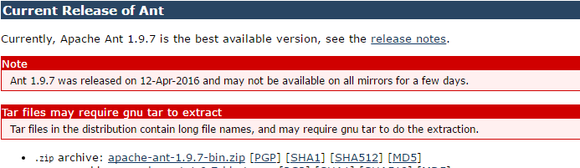
Get Ant

Slide 7
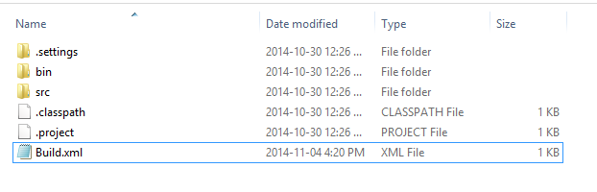
Creating an Ant file
Create a file called Build.xml in the root of your project

Slide 8
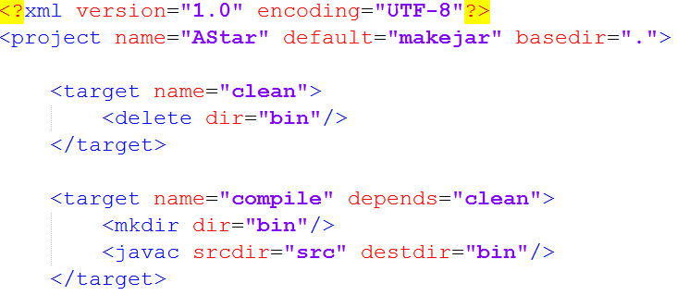
Dissecting an ANT file
Go to the AStarExample and find the build file (https://github.com/sahilluthra/ecse321tutF2016)

Slide 9
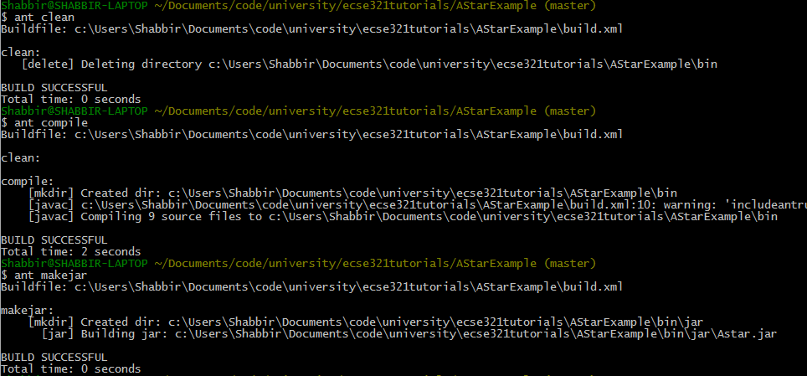
Running an ant File

Slide 10
Exercise
Create ANT build file for your group project that can generate a jar file.

Slide 11
Generate ANT file
Right click on your project
Export
General->ant build file
Hit okay

Slide 12
References
Shabbir Hussain’s Tutorial:
https://github.com/shabbir-hussain/ecse321tutW16
Integrating ANT into eclipse:
http://help.eclipse.org/luna/index.jsp?topic=%2Forg.eclipse.platform.doc.user%2FgettingStarted%2Fqs-93_project_builder.htm
https://www.tutorialspoint.com/ant/index.htm

